Slide 2
Agenda
What’s RxJS
Core concepts in RxJS
Observable
Create an Observable
Subscribing to Observables
Operators
Subject

Slide 3

What’s RxJS
“RxJS (The Reactive Extensions for JavaScript) is a library for composing asynchronous and event-based programs by using observable sequences.”
——reactivex.io/rxjs

Slide 4
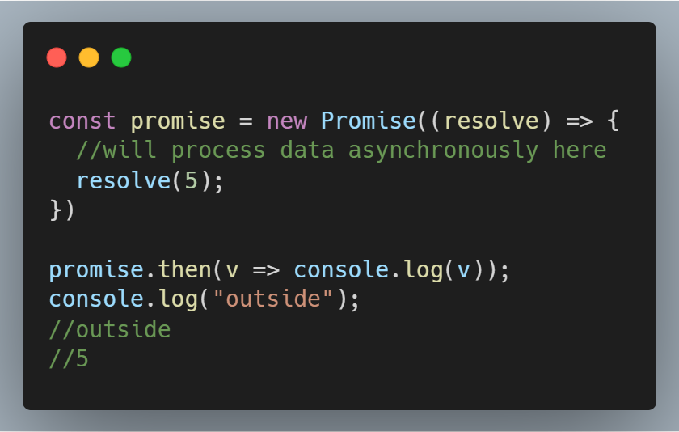
Asynchronous Programming in JavaScript
Promises (introduced in ES6)
Async/Await (introduced in ES8)
RxJS Observables

Slide 5
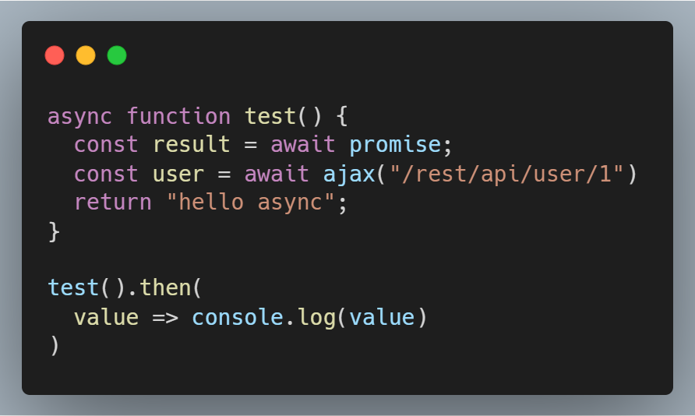
Asynchronous Programming in JavaScript
Promises (introduced in ES6)
Async/Await (introduced in ES8)
RxJS Observables

Slide 6

Asynchronous Programming in JavaScript
Promises (introduced in ES6)
Async/Await (introduced in ES8)
RxJS Observables

Slide 7
Why RxJS Observables?
The ability to handle multiple asynchronous events
Cancelable
Deliver multiple values
Synchronous or asynchronous
Provide many data stream operators
……

Slide 8
Core Concepts in RxJS
Observable: represents the idea of an invokable collection of future values or events.
Observer: is a collection of callbacks that knows how to listen to values delivered by the Observable.
Subscription: represents the execution of an Observable, is primarily useful for cancelling the execution.
Operators: are pure functions that enable a functional programming style of dealing with collections with operations like map, filter, concat, reduce, etc.
Subject: is an Observable and an Observer, and the only way of multicasting a value or event to multiple Observers.
Schedulers: are centralized dispatchers to control concurrency, allowing us to coordinate when computation happens on e.g. setTimeout or requestAnimationFrame or others.

Slide 9
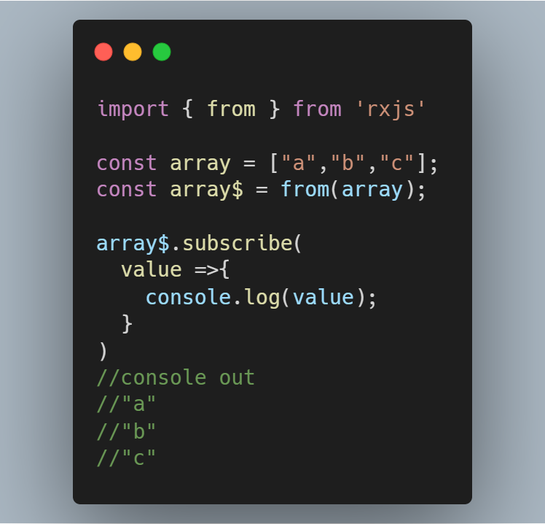
Create An Observable
from()
of()
fromEvent()
timer()
Interval()

Slide 10
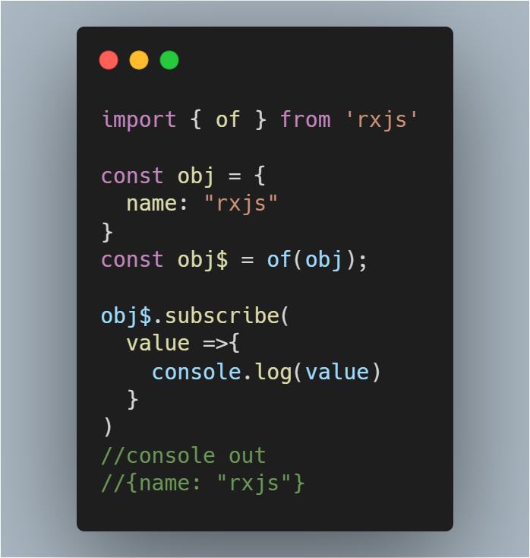
Create An Observable
from()
of()
fromEvent()
timer()
Interval()

Slide 11
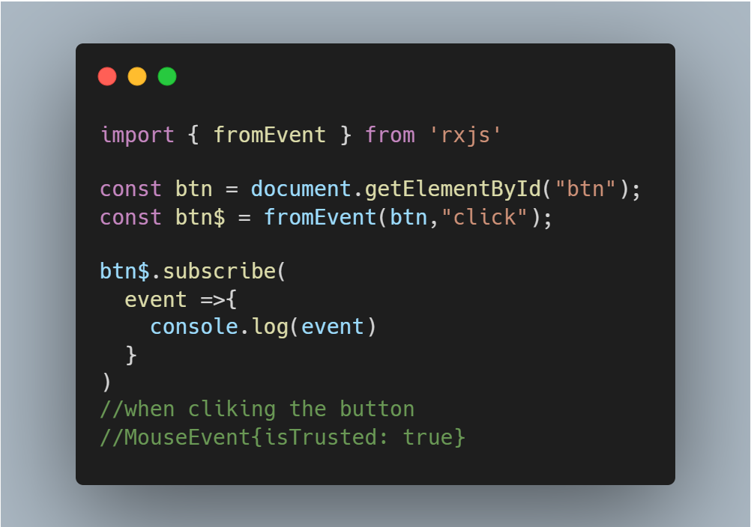
Create An Observable
from()
of()
fromEvent()
timer()
Interval()

Slide 12
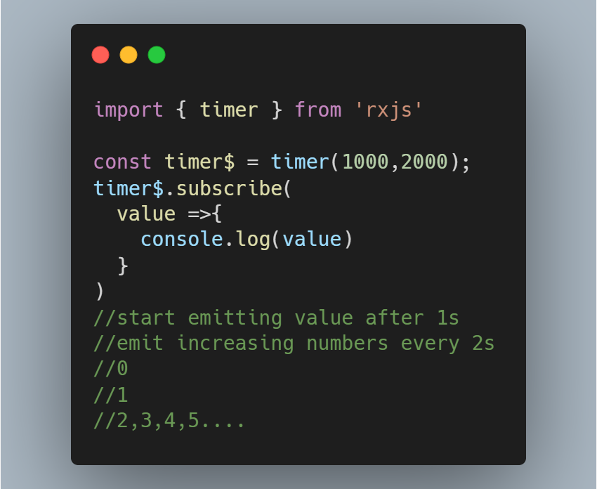
Create An Observable
from()
of()
fromEvent()
timer()
Interval()

Slide 13
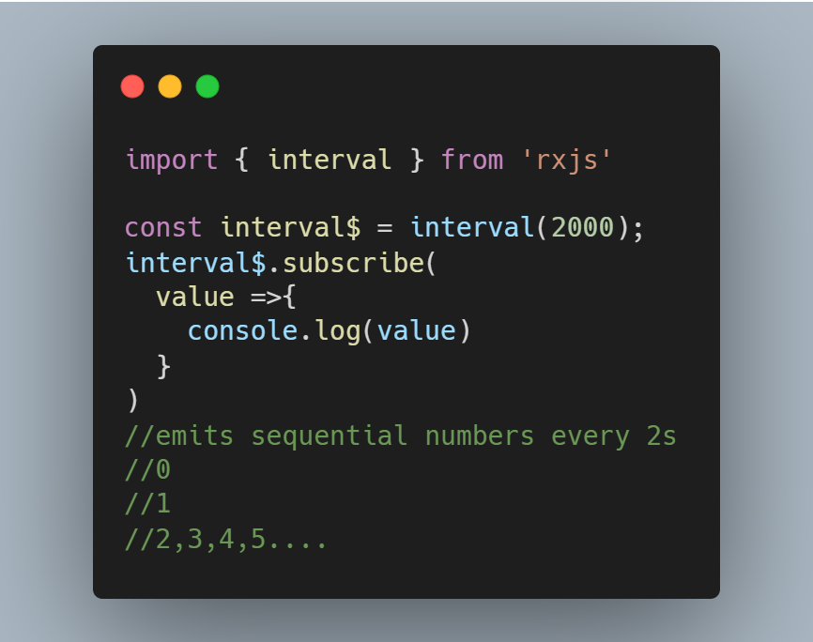
Create An Observable
from()
of()
fromEvent()
timer()
Interval()

Slide 14
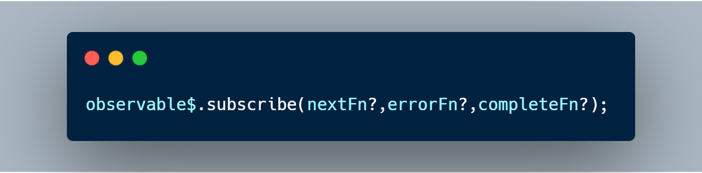
Subscribing to Observables
The observable’s subscribe method allows you to pass three callback methods as parameters.
Whenever the data arrives, the nextFn will be invoked to process the data.
Before the data arrives if an exception happens, the errorFn will be invoked to handle the error.
When all the data has been emitted successfully, the completeFn will be invoked.
If error occurred, the afterwards data will not be delivered and the completeFn will be not invoked.

Slide 15
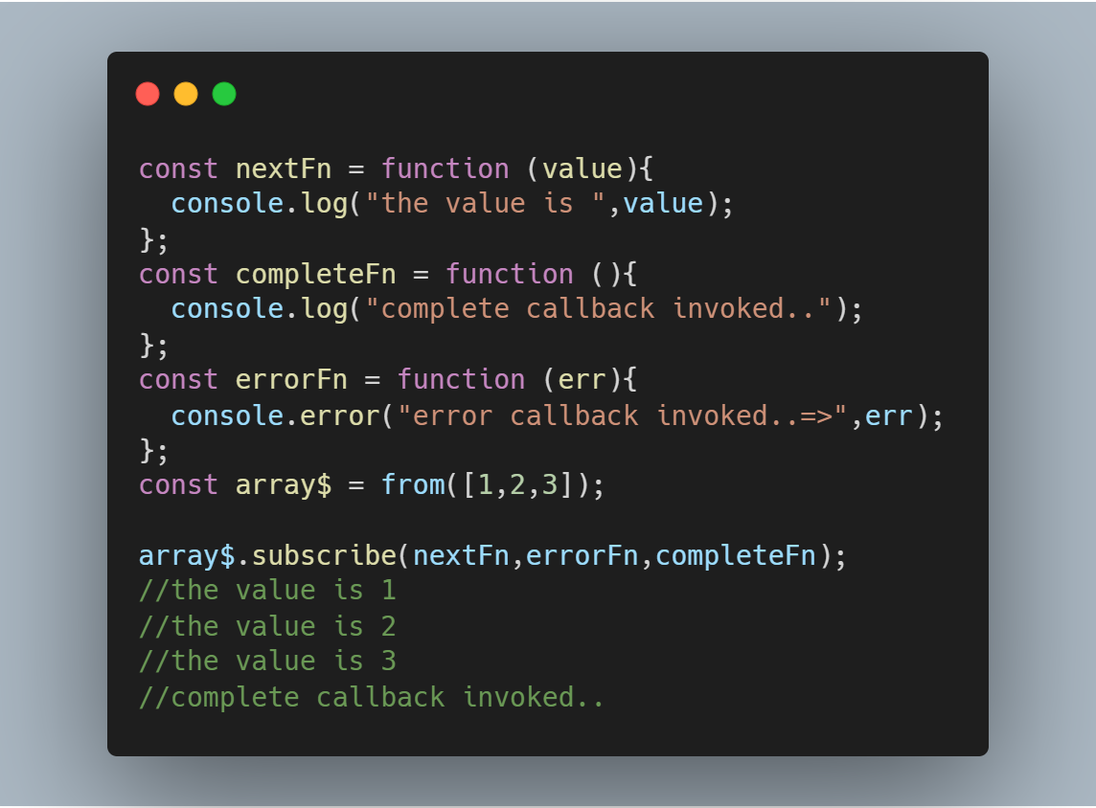
Subscribing to Observables

Slide 16
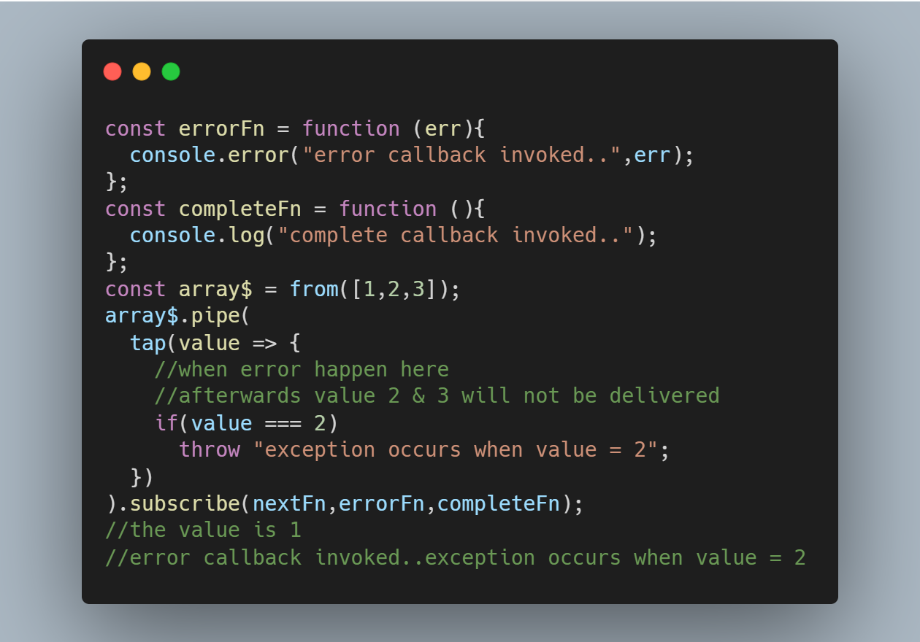
Subscribing to Observables

Slide 17
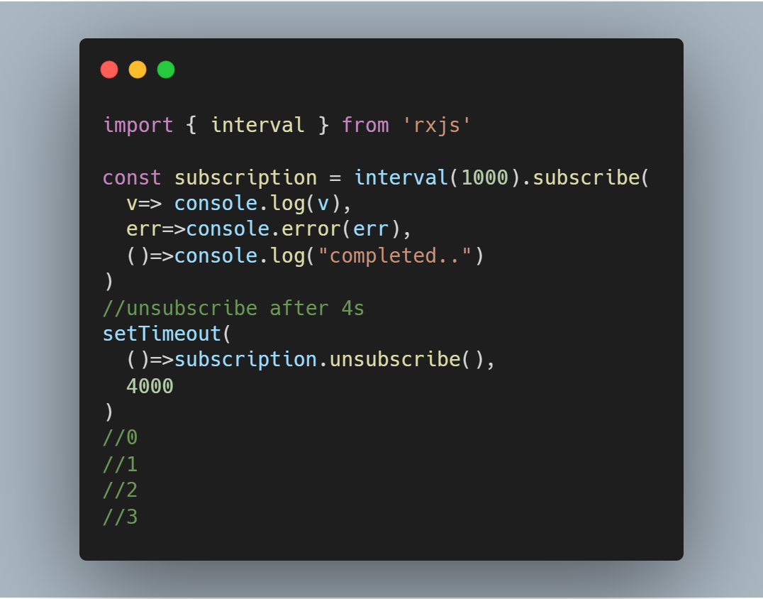
What is a Subscription?
A Subscription is an object that represents the execution of an Observable.
A Subscription has an unsubscribe() function to release resources or cancel Observable executions.

Slide 18
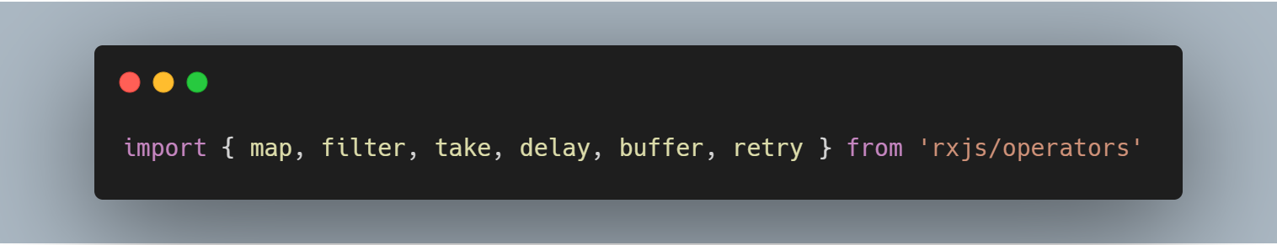
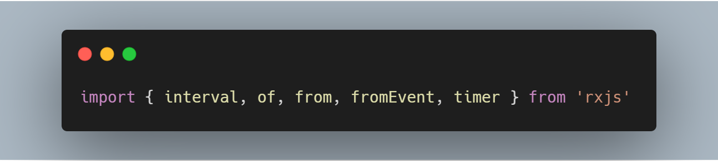
Operators
Pipeable Operator
Creation Operator

Slide 19
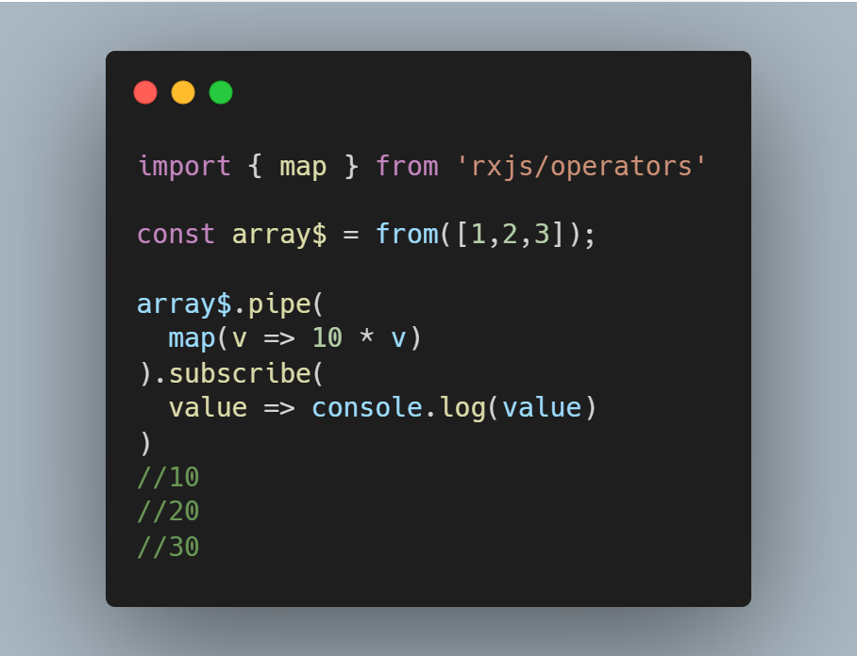
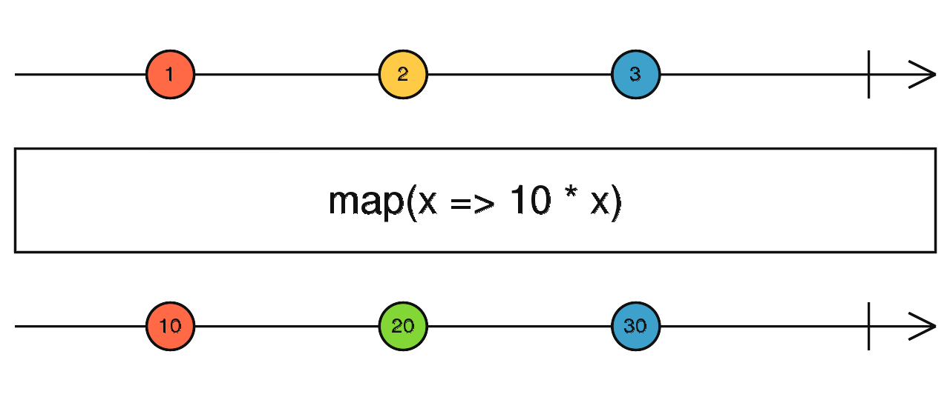
Operators
map()

Slide 20
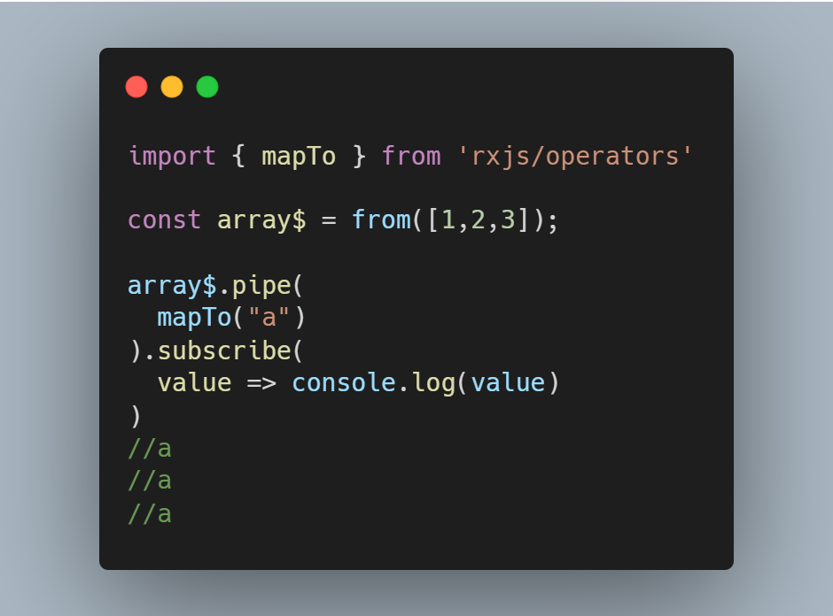
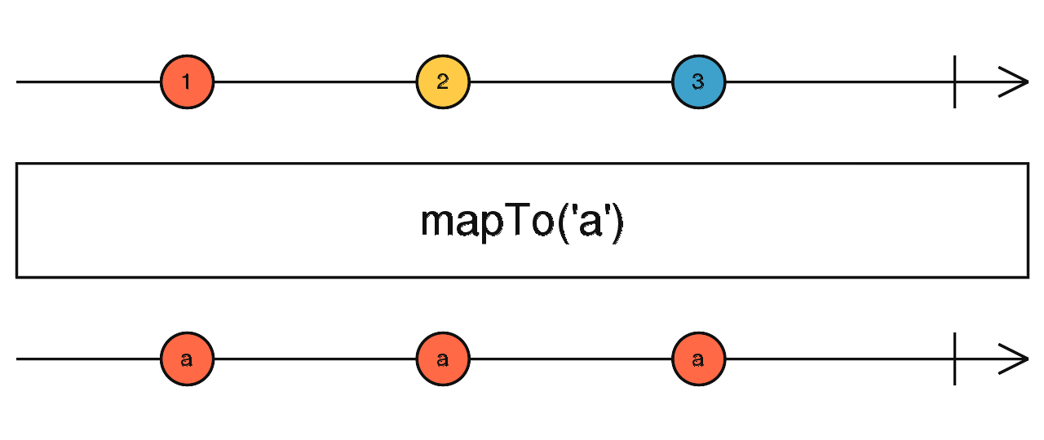
Operators
mapTo()

Slide 21
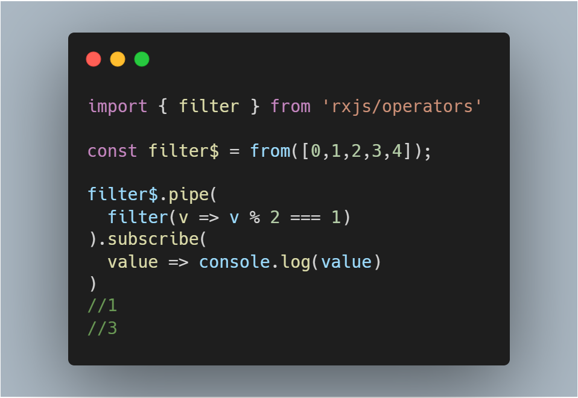
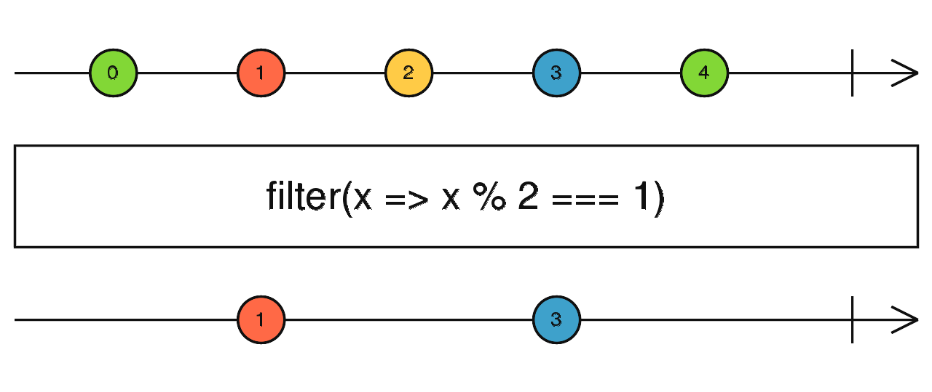
Operators
filter()

Slide 22
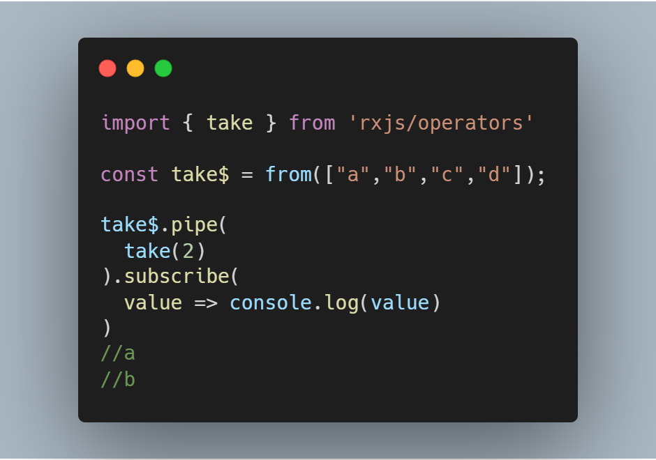
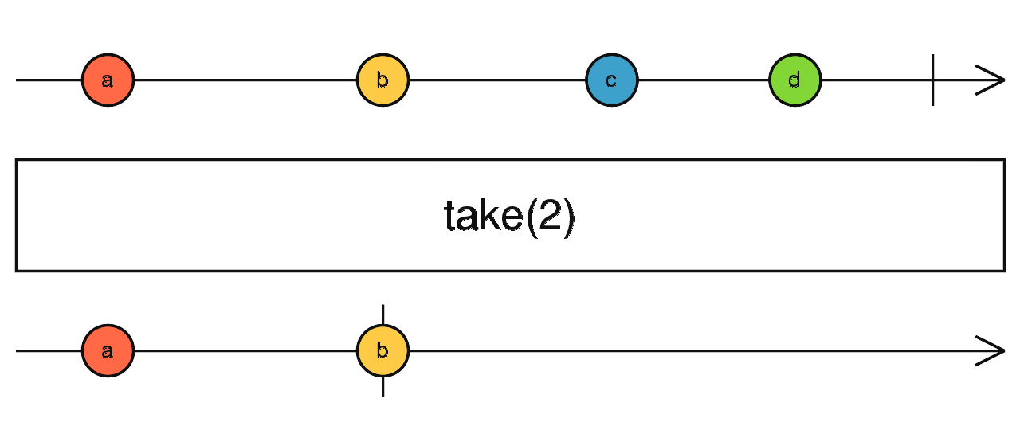
Operators
take()

Slide 23
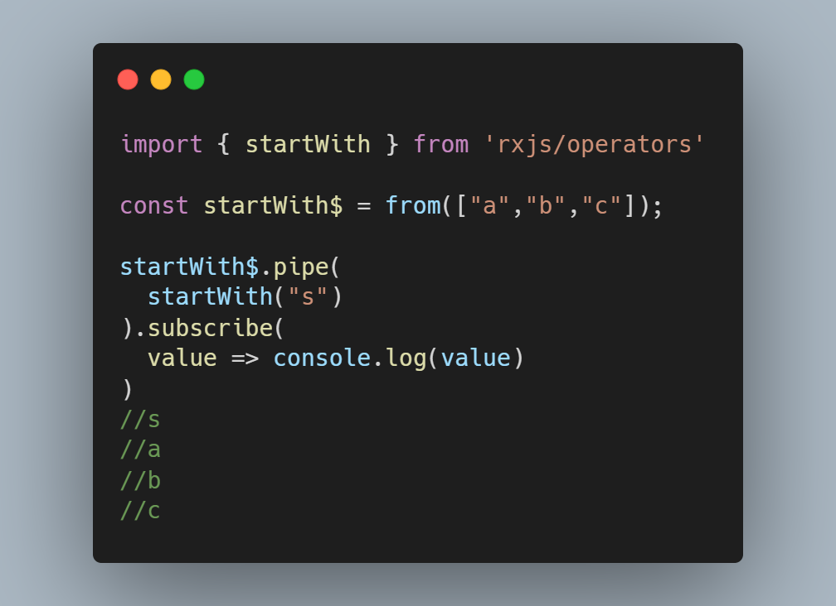
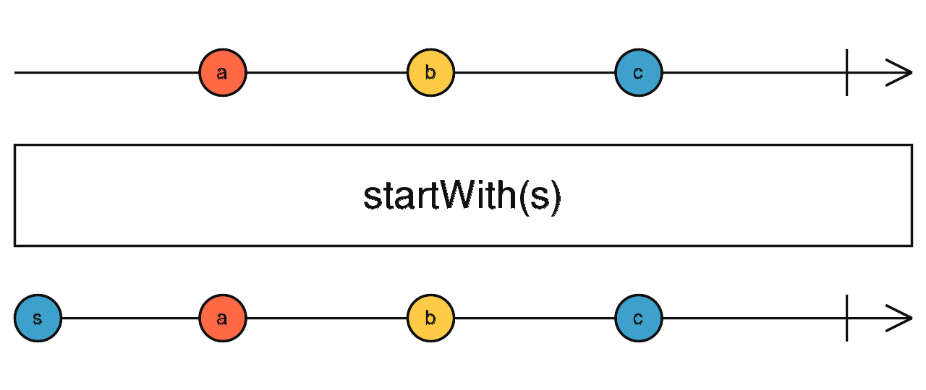
Operators
startWith()

Slide 24
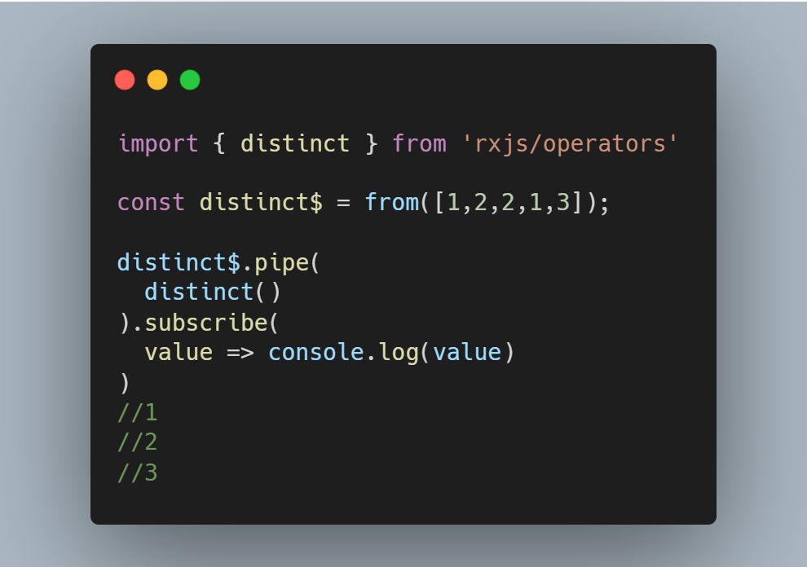
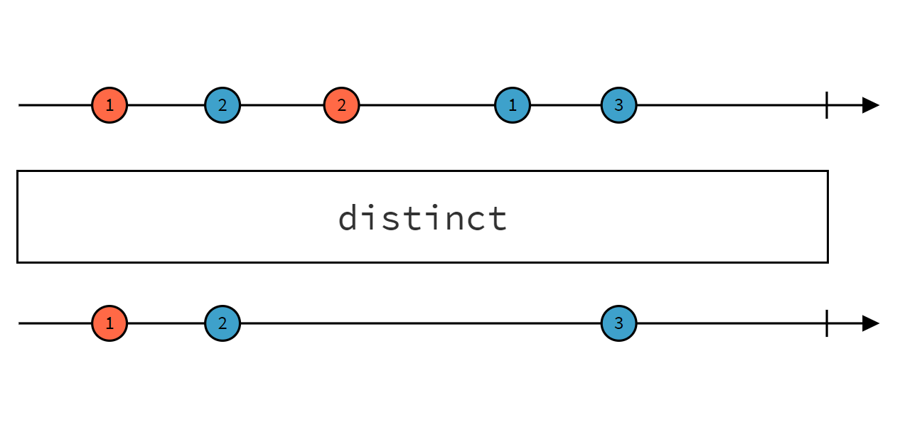
Operators
distinct()

Slide 25
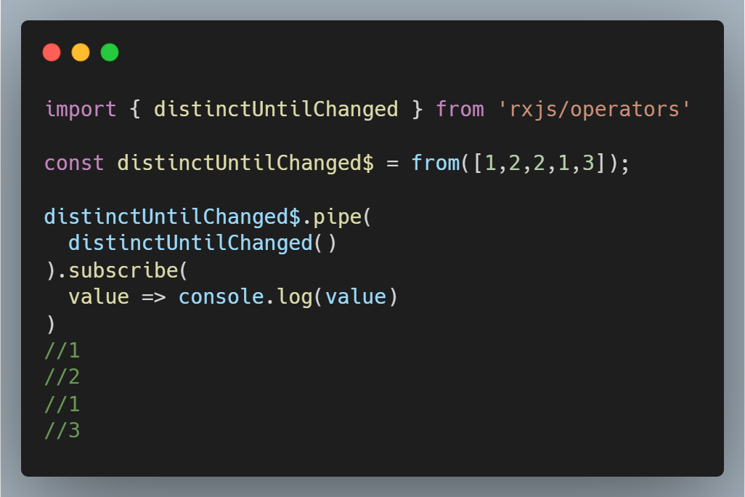
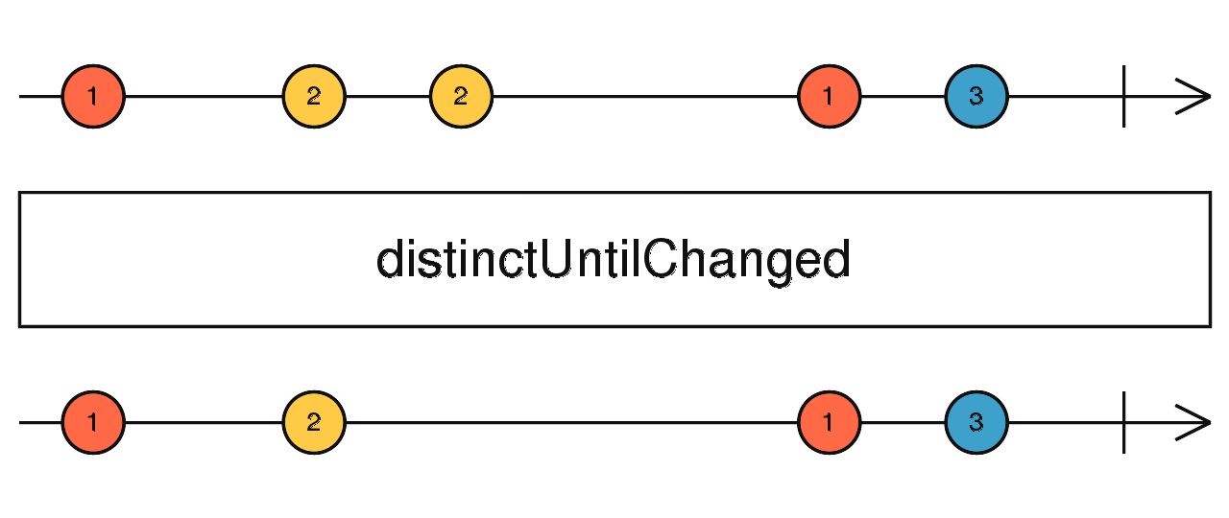
Operators
distinctUntilChanged()

Slide 26
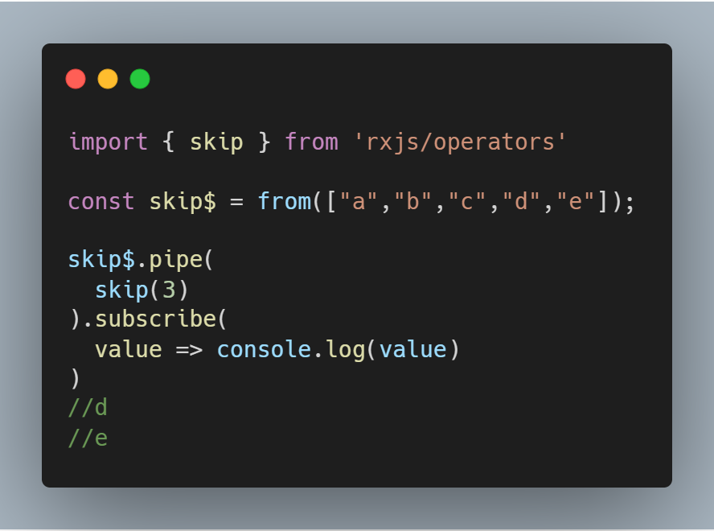
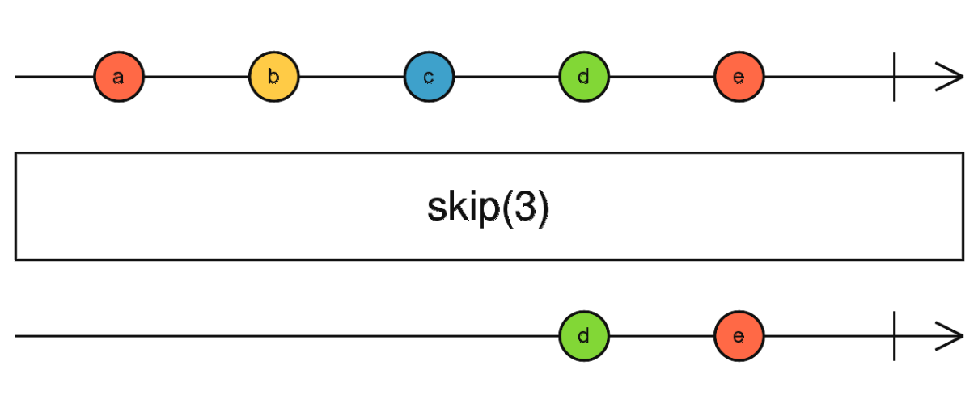
Operators
skip()

Slide 27
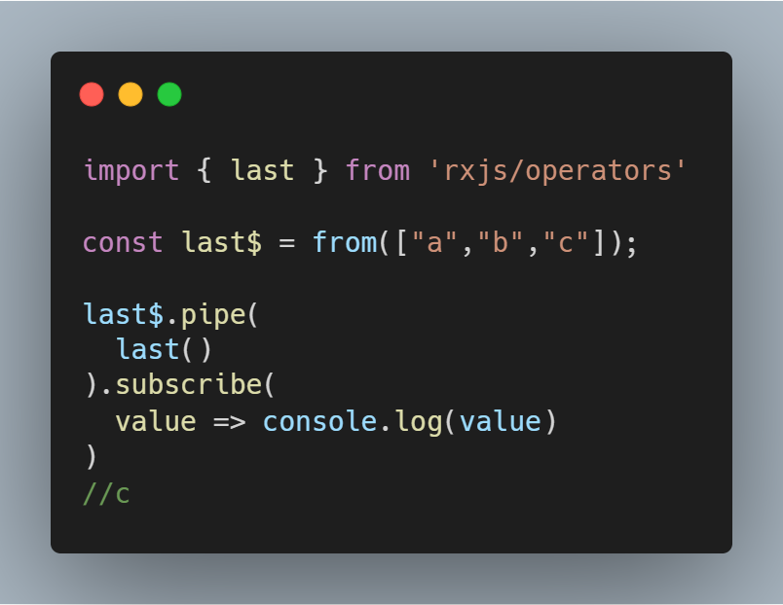
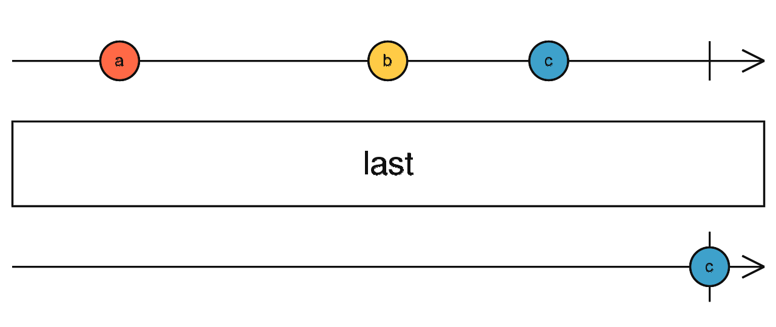
Operators
last()

Slide 28
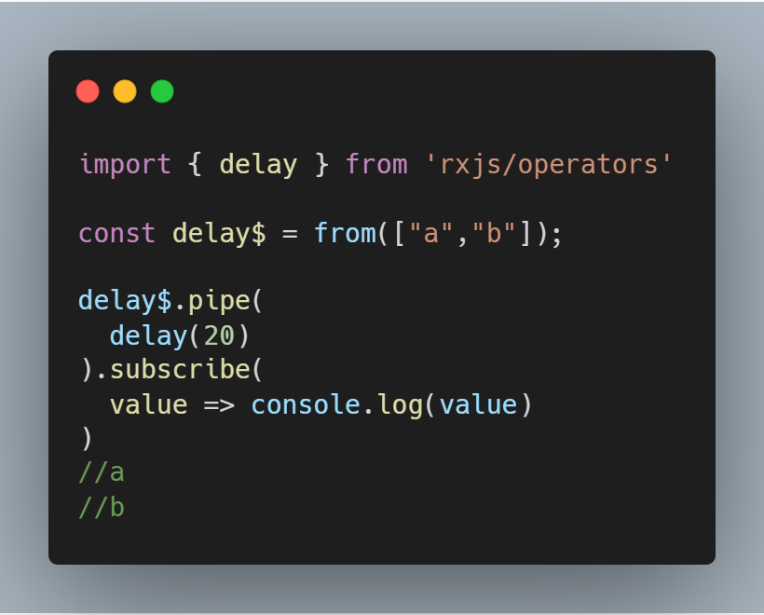
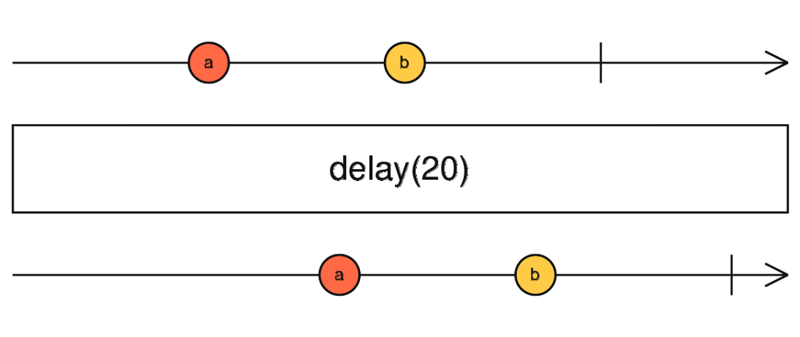
Operators
delay()

Slide 29
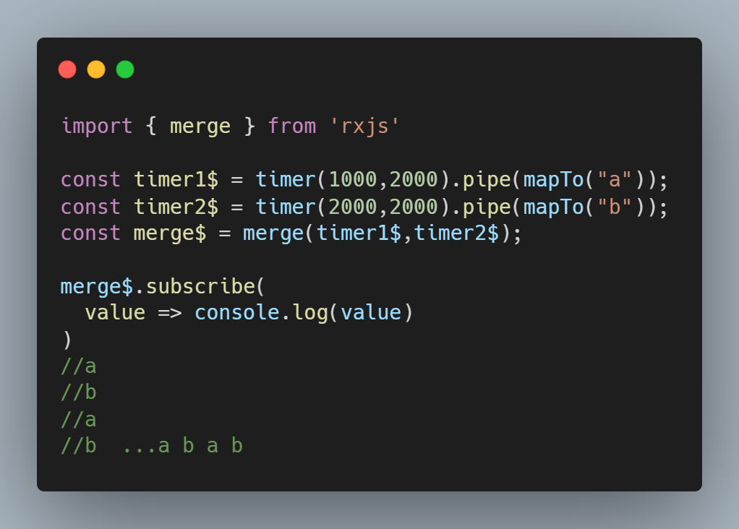
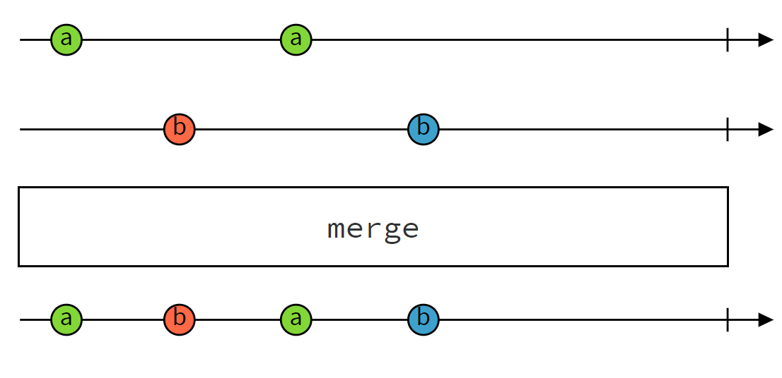
High-Level Operators
merge()

Slide 30
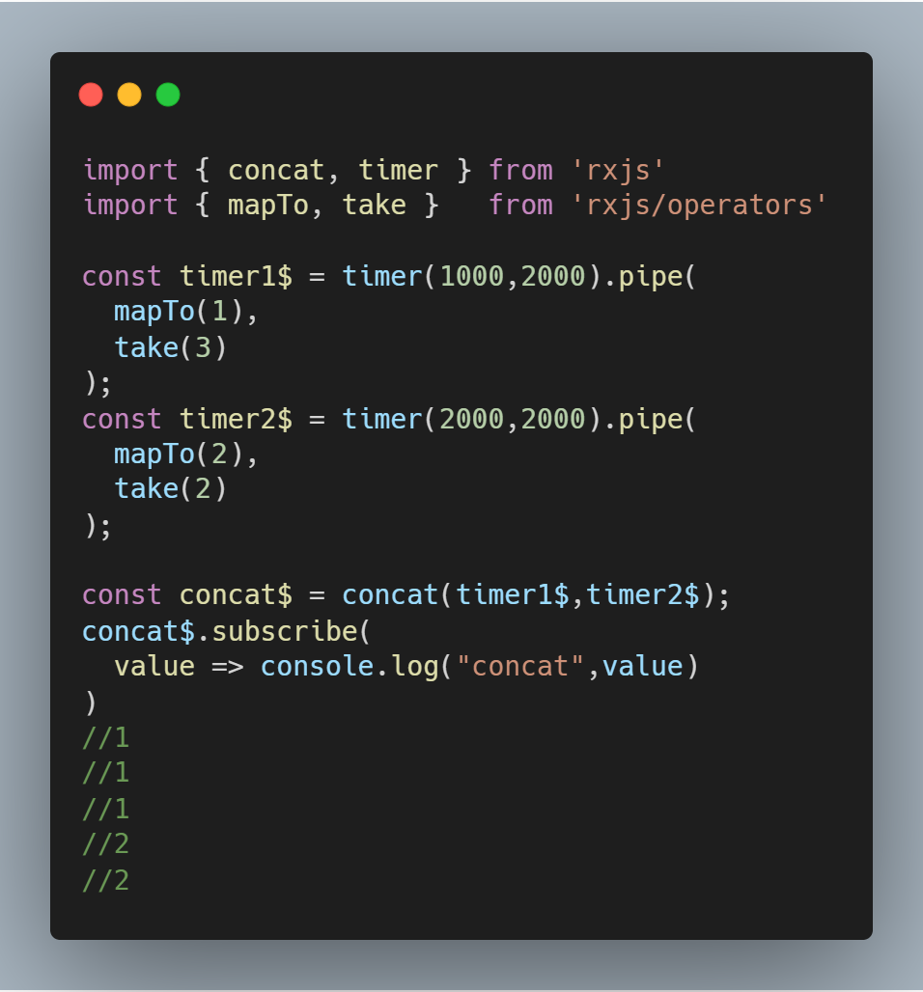
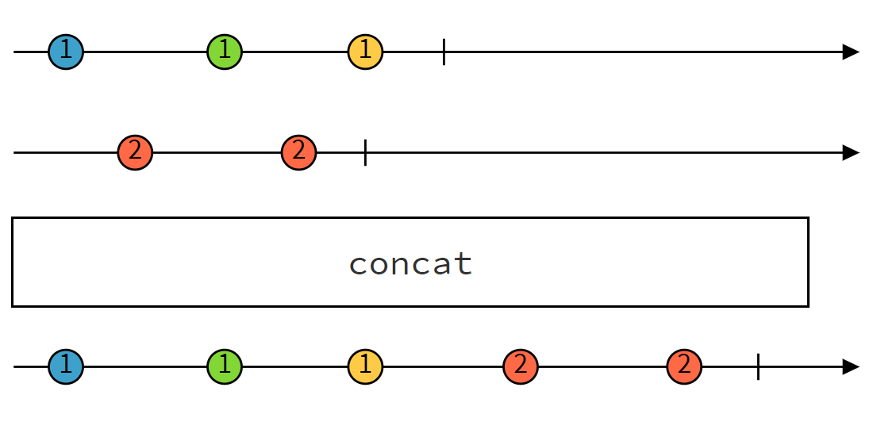
High-Level Operators
concat()

Slide 31
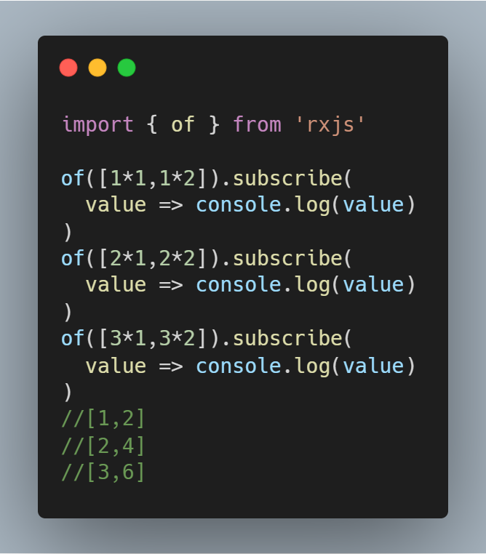
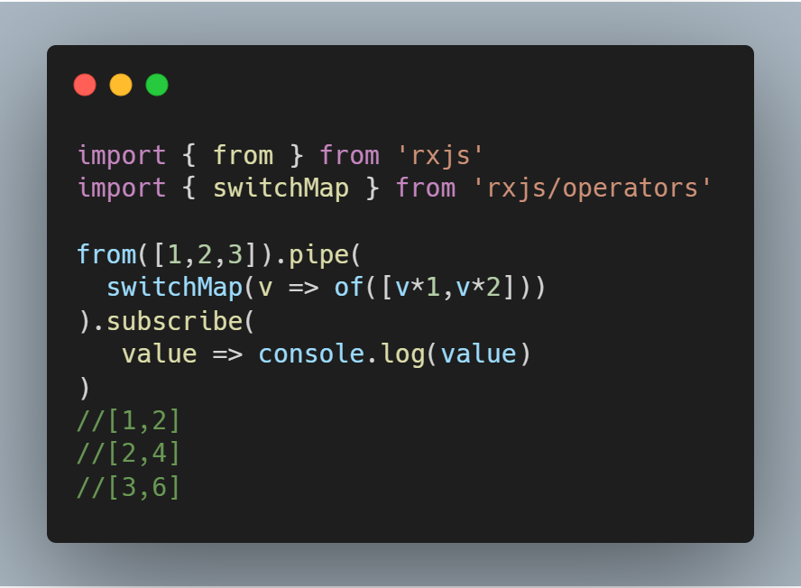
High-Level Operators
switchMap()
Maps each value to an inner Observable

Slide 32
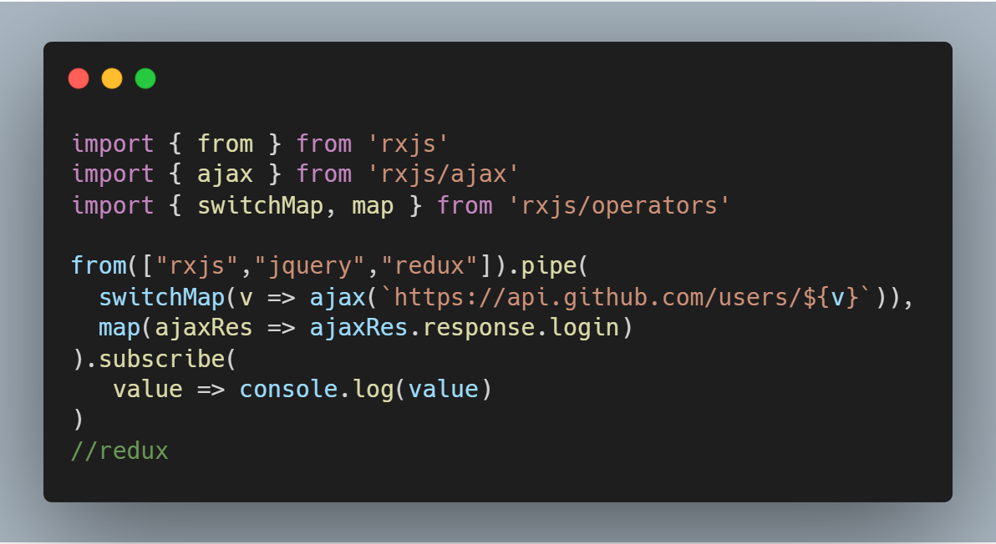
High-Level Operators
switchMap()
Cancel previous uncomplete inner Observable

Slide 33
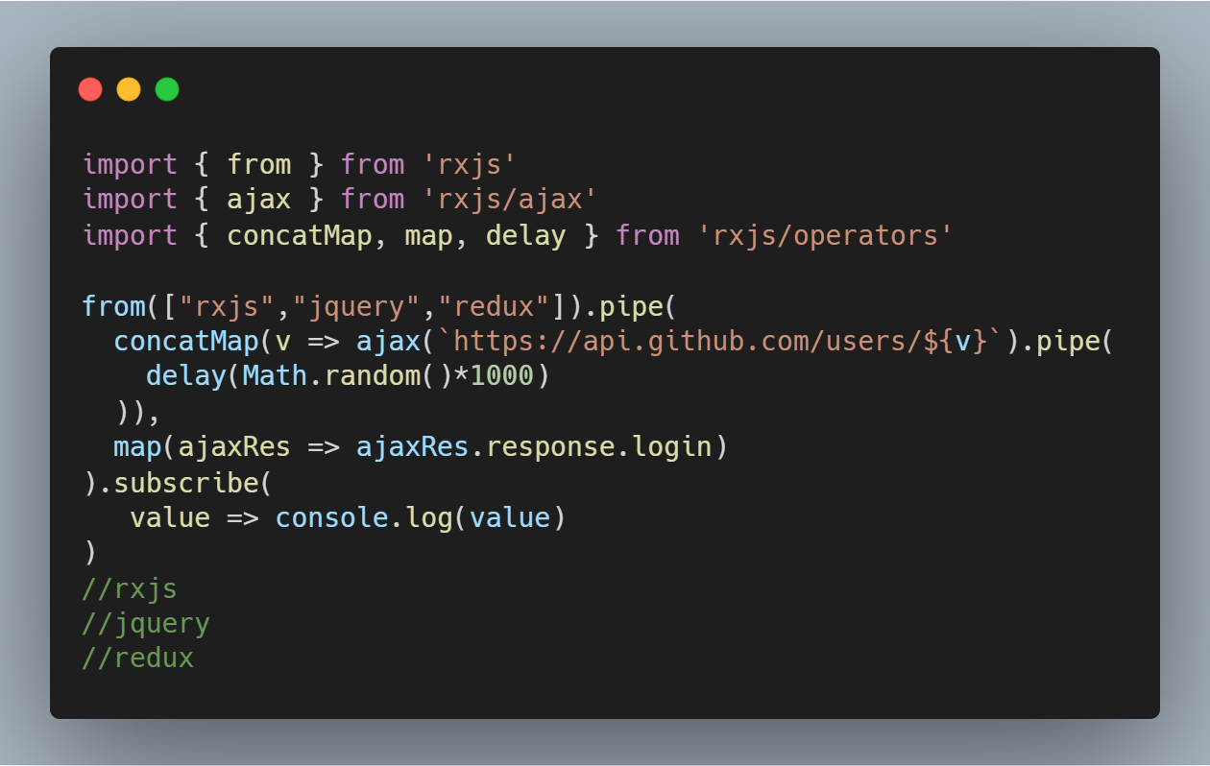
High-Level Operators
concatMap()
Map each value to inner observable, subscribe and emit in order.

Slide 34
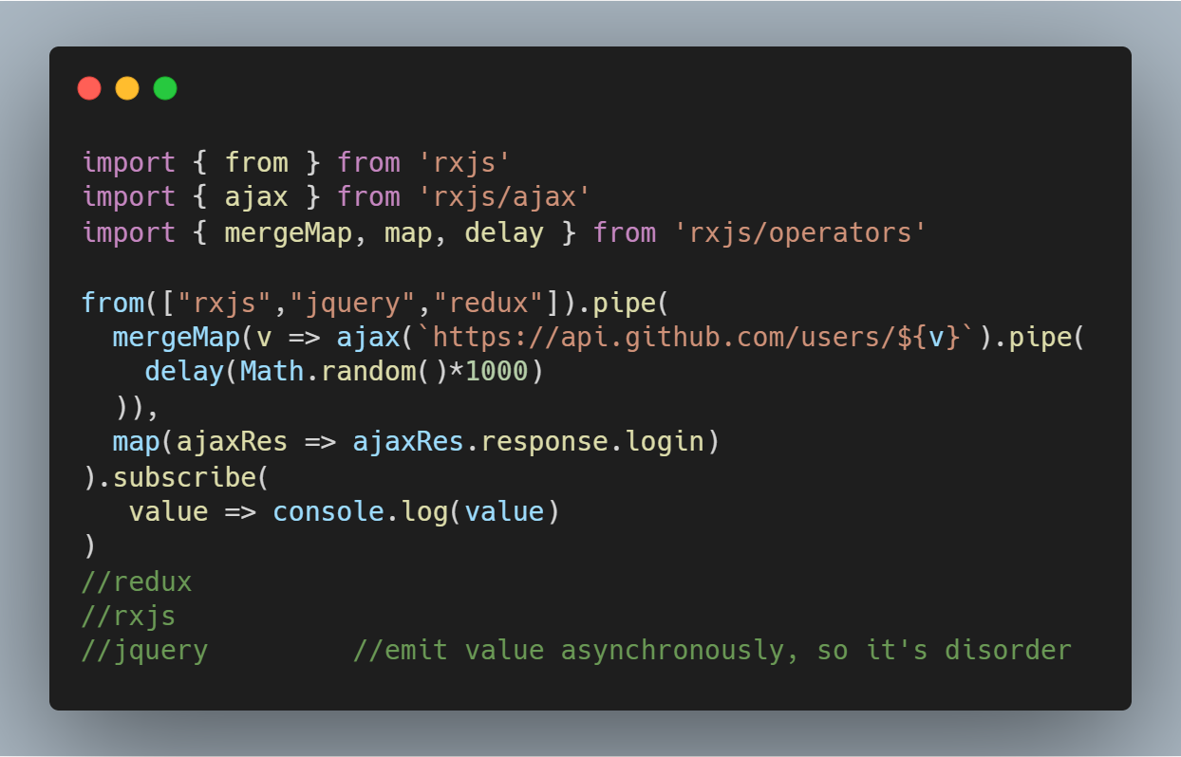
High-Level Operators
mergeMap() / flatMap()
Map each value to inner observable, subscribe and emit asynchronously.

Slide 35
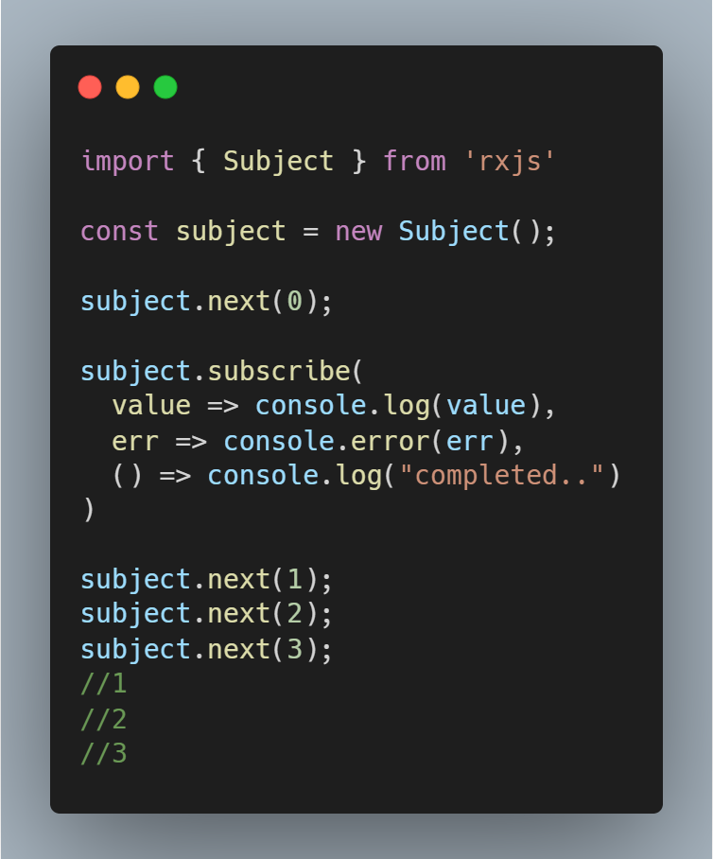
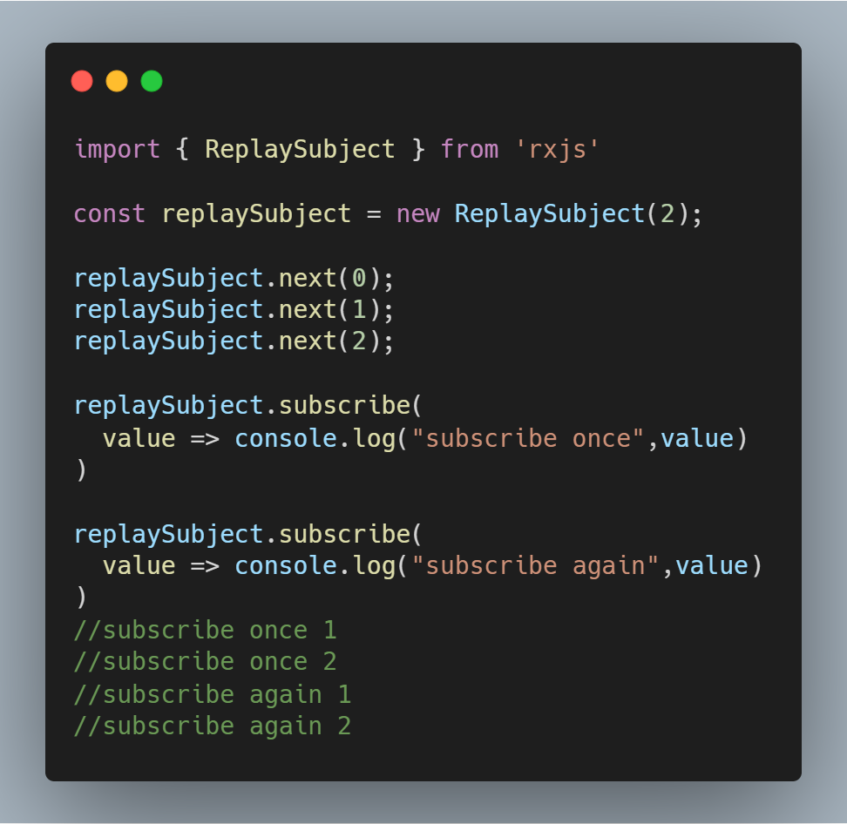
Subject
Every Subject is an Observable and an Observer. You can subscribe to a Subject, and you can call next to feed values as well as error and complete.

Slide 36
Live demo resources
Create Observables
Subscribe to an Observable
Operators
High-Level operators
Subject

Slide 37

Thanks！

